Slide 1
Tokens

Slide 2
The smallest individual units in a program is known as tokens.
C++ has the following tokens:
Keywords
Identifiers
Constants
Strings
Operators

Slide 3
Keywords

Slide 4
Keywords are those words whose meaning has already been explained to the compiler.
Keywords are also known as Reserved words.
The keywords cannot be used as variables names.

Slide 5
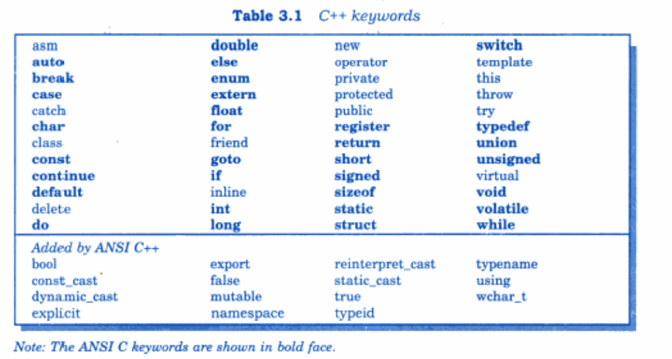

Slide 6
Identifiers or Variables

Slide 7
C and C++, both the languages have common rules for naming conventions.
ANSI C++ places no limit on its length.

Slide 8
Variable:
An entity that may change during program execution is called a variable.
Variable names are names given to locations in memory.
These locations can contain integer, real or character constants.

Slide 9
The types of variables that it can support depend on the types of constants that it can handle. This is because a particular type of variable can hold only the same type of constant.

Slide 10
Rules to Declare Variable

Slide 11
1. The first character in the variable name must be an alphabet or underscore.
Valid variable names: Sum, a1, _temp, TOTAL
Invalid variable names: 5a, #s

Slide 12
2. No commas or blanks are allowed within a variable name.
Invalid variables: Total,number sum of numbers valid Variables: Total_number sum_of_numbers

Slide 13
3. No special symbol other than an underscore can be used in a variable name.
Valid variable Names: Total_number sum_of_numbers
Invalid variable Names: Total#number sum@of-numbers

Slide 14
4. keywords cannot be used as variable names.
Valid variable Names: INT, LONG
Invalid variable Names: int, float, void etc.

Slide 15
Constants

Slide 16
Constants
Primary Constants
Secondary Constants
Numeric Constants
Character Constants
Array
Pointer
Structure
Pointer
Union
Enumerations

Slide 17
Numeric Constants
Integer Constants
Real Constants

Slide 18
Real Constants
Floating Point Constants
Exponential Constants

Slide 19
Character Constants
Single Character Constants
String Constants

Slide 20
String

Slide 21
The collection of Characters terminated by null character is known as string.

Slide 22
Relational Operators

Slide 23
<
>
<=
>=
==
!=

Slide 24
Logical Operators

Slide 25
1. Logical AND: &&
2. Logical OR: ||
3. Logical NOT: !

Slide 26
Bitwise Operators

Slide 27
1. Bitwise AND: &
2. Bitwise OR: ||
3. Bitwise NOT: ~
4. Bitwise left shift <<
5. Bitwise right shift >>
6. Bitwise XOR ^

Slide 28
Bitwise AND
The result of AND is 1 only if both bits are 1.
A | B | A & B
0 | 0 | 0
1 | 0 | 0
0 | 1 | 0
1 | 1 | 1
Bitwise OR
The result of OR is 1 if any of the two bits is 1.
A | B | A | B
0 | 0 | 0
1 | 0 | 1
0 | 1 | 1
1 | 1 | 1

Slide 29
Bitwise XOR
The result of XOR is 1 if the two bits are different.
A | B | A ^ B
0 | 0 | 0
1 | 0 | 1
0 | 1 | 1
1 | 1 | 0
Bitwise NOT
It inverts all bits of it
A | ~A
0 | 1
1 | 0

Slide 30
Bitwise Left Shift
Bitwise Right Shift

Slide 31
Thank You

